Slide 1
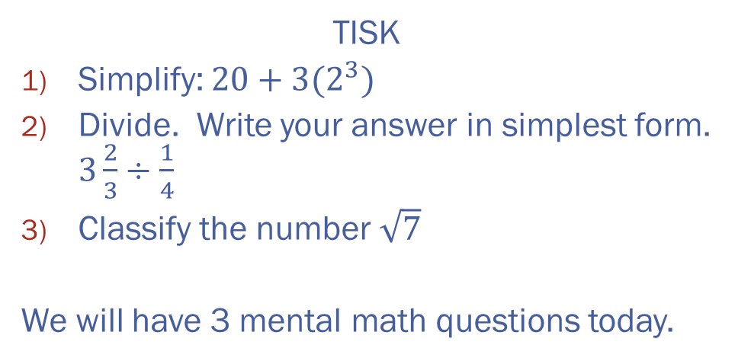
Tuesday, August 14, 2012
TISK
Simplify: $20+3(2^{3})$
Divide. Write your answer in simplest form. $3\frac{2}{3}÷\frac{1}{4}$
Classify the number $\sqrt{7}$
We will have 3 mental math questions today.

Slide 2
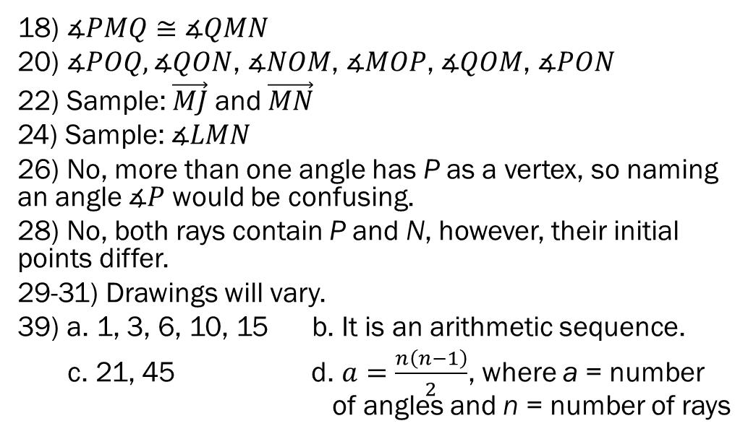
Homework Check
18) $∡PMQ≅∡QMN$
20) $∡POQ,∡QON$, $∡NOM$, $∡MOP$, $∡QOM$, $∡PON$
22) Sample: $\vec{MJ}$ and $\vec{MN}$
24) Sample: $∡LMN$
26) No, more than one angle has P as a vertex, so naming an angle $∡P$ would be confusing.
28) No, both rays contain P and N, however, their initial points differ.
29-31) Drawings will vary.
39) a. 1, 3, 6, 10, 15 b. It is an arithmetic sequence.
c. 21, 45 d. $a=\frac{n\left(n−1\right)}{2}$, where a = number of angles and n = number of rays

Slide 3
Angle Relationships
and
A
are Vertical Angles, because…
B
E
C
They have the same vertex…
D
And their sides are opposite rays!
Can you name another pair of vertical angles in this picture?

Slide 4
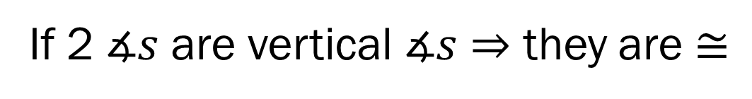
Exploring Vertical Angles
An important theorem we will use a lot this year:
Vertical Angles Theorem
If two angles are vertical angles, then they are congruent.
If 2 $∡s$ are vertical $∡s⇒$ they are $≅$

Slide 5
Angle Relationships
and
are a linear pair, because…
C
A
B
…they are adjacent…
D
…and their noncommon sides form a line

Slide 6
Exploring Linear Pairs
An important postulate we will use often:
Linear Pair Postulate
If two angles form a linear pair, then the sum of their angle measures is 180º.
If 2 $∡s$ are a$linear pair⇒$ their sum = 180$°$

Slide 7




Example 1.
a. Are $∡1$ and $∡2$ a linear pair?
Yes!
b. Are $∡4$ and $∡5$ a linear pair?
2
3
No!
1
4
5
c. Are $∡3$ and $∡5$ vertical angles?
No!
d. Are $∡1$ and $∡3$ vertical angles?
Yes!

Slide 8
Example 2.
Solve for x and y. Then find the angle measures.
M
+
= 180º
L
P
N
O
+
= 180º

Slide 9

Check Points!
1. Name one pair of vertical angles and one pair of angles that form a linear pair.
I
J
H
K
G
2. What is the measure of $∡GHI$?

Slide 10
Angle Relationships
Complementary Angles (def.): Two angles whose measures have a sum of 90º.
1
2
complementary, adjacent
complementary, nonadjacent

Slide 11
Angle Relationships
Supplementary Angles (def.): Two angles whose measures have a sum of 180º.
1
2
supplementary, adjacent
supplementary, nonadjacent

Slide 12







Example 3.
Given that $∡G$ is a supplement of $∡H$ and $m∡G$ is $82°$, find $m∡H$.
Given that $∡U$ is a complement of $∡V$ and $m∡U$ is $73°$, find $m∡V$ .
$$m∡G+m∡H=180$$
$$82+m∡H=180$$
$$m∡H=98$$
$$m∡U+m∡V=90$$
$$73+m∡V=90$$
$$m∡V=17$$

Slide 13

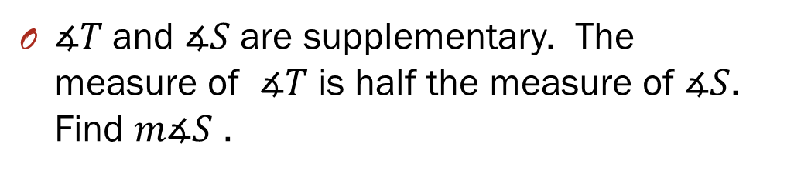





Example 4.
$∡T$and $∡S$ are supplementary. The measure of $∡T$ is half the measure of $∡S$. Find $m∡S$ .
$$m∡T+m∡S=180$$
$$m∡T=\frac{1}{2}m∡S$$
$$\frac{1}{2}m∡S+m∡S=180$$
$$m∡S+2m∡S=360$$
$$3m∡S=360$$
$$m∡S=120$$

Slide 14
Homework
p. 59 #28-34, 36

